Slide 1

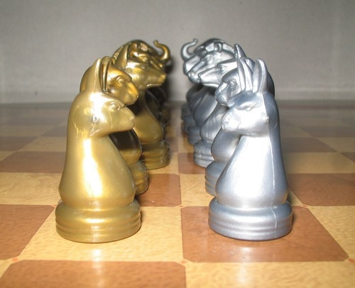
Fast and furious Game Playing : MonteCarlo drift
Students :
Prateek Bhatnagar Baptiste Bignon Mikaïl Demirdelen Gabriel Prevosto Dan Seeruttun--Marie Benoît Viguier
Supervisors :
Nikolaos Parlavantzas Christian Raymond
Year 2014-2015

Slide 2
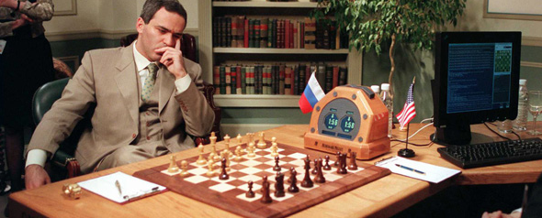
Introduction
Garry Kasparov (Russia) vs Deep Blue (IBM - USA), 1997

Slide 3
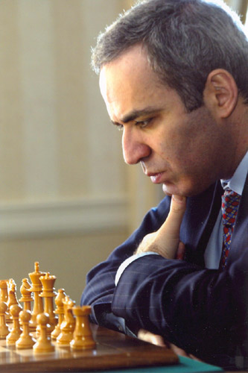
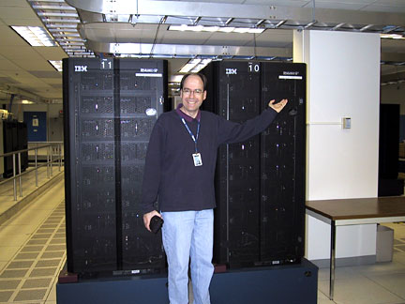
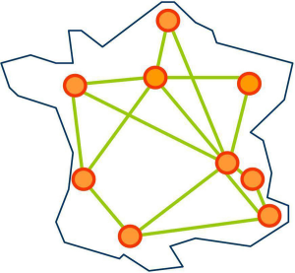

Introduction
Deep Blue
Calculus power : 11.38 GFLOPS
Evaluate between 100 and 300 million positions per second.
Read 12 moves ahead.
Garry Kasparov
Read 3 to 5 moves ahead
12 to 14 moves depending on the position.
Dell Precision T1700
Grid'5000
Calculus power : 125 GFLOPS
Calculus power > 10 TFLOPS
1 FLOPS = 1 float operation per second.

Slide 4
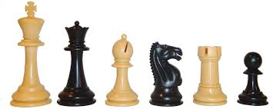

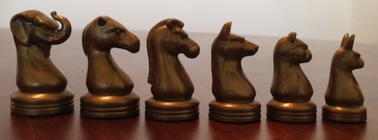
Project Presentation
Goal of the project :
Generate an AI for an unsolved 2 players board game
Arimaa

Slide 5
Project Presentation
Which algorithm to use ?
Game | Average number of moves | Moves read ahead by Deep Blue | AI used
Chess | 35 | 12 | Minimax
Game of Go | 250 | 8 | MCTS
Arimaa | 20 000 | 4 | Minimax & MCTS
Minimax : algorithm that evaluate most of the possible positions.
Monte Carlo Tree Search : cutting edge of the AI research algorithm.
Notes:
ajouter minimax explication

Slide 6


Project Presentation
Project goals :
Use a calculus power using
CPU parallelization
GPU parallelization
Develop the solution on
1 Computer
Computers of our department
Grid'5000, IRISA
Notes:
Here is the presentation of our project. Our purpose will be to build an Artificial Intelligence for a 2 players strategy board game, but not entirely solved like checkers, or Dames in French, but not to much studied like Chess.
For our Artificial Intelligence, we will use the MCTS algorithm, a very knowed algorithm able to calculate one of the best moves to play. The MCTS algorithm don't guess all moves possible, it just select the best moves and develop them, to see where they leads. Then, it computes statistics to make it possible to select a move.
Then we will apply the algorithm to game, beginning by simple one like TicTacToe, or Morpion, and Connect 4, or Puissance 4. Then, we will apply to the non solved game Arimaa, similar to Chess when we see the board, but with so much possibilities it is impossible to solve it with a computer.
We will choose away to compute the tree of moves, between different types of parallelization.
To improve the power of our computation, we will run it using CPU parallelization of our computers, then GPU parallelization on our graphical card of our computers, and Finally in Grid'5000, The cluster of computers handled by the IRISA.

Slide 7
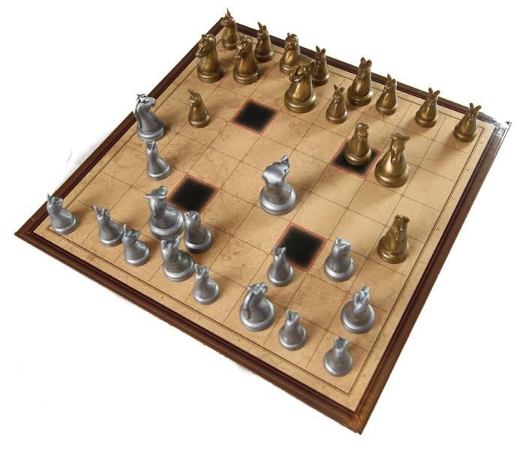
Contents
Introduction
Arimaa presentation
MCTS algorithm
Parallelization methods
General architecture
Specifications
Development Methodologies
Conclusion

Slide 8
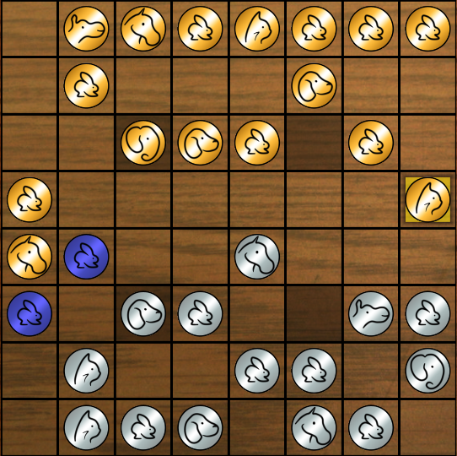
Arimaa
The game
Plays on a chess board
Follows simple rules
Difficult to play for artificial intelligence
Unlike for chess, no algorithm running on a modest personal computer can best the human champions

Slide 9
Arimaa
The rules : Basic rules
Each player starts off with 16 pieces, as follows :
Each player disposes of 4 moves per turn
A win is achieved by having a rabbit reaching the opposite side of the board

Slide 10
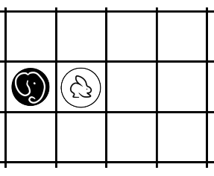
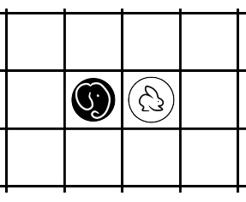
Arimaa
The rules :
Displacement
Pieces can move on any adjacent square, but not diagonally.
Any piece can use two moves to push or pull an adjacent enemy piece, if said piece is weaker.

Slide 11
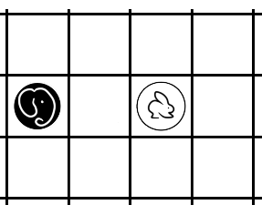
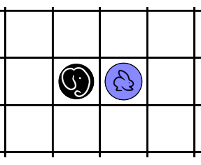
Arimaa
The rules :
Freezing
A piece standing next to a stronger enemy piece cannot move unless there is an ally piece beside it.

Slide 12
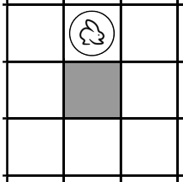
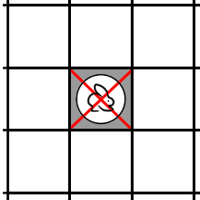
Arimaa
The rules :
Traps
Each piece standing on a trap dies, unless there is an ally piece beside it.

Slide 13

Arimaa
The rules
That's it !
Simple isn't it ?
But not for computers.

Slide 14
Contents
Introduction
Arimaa presentation
MCTS algorithm
Parallelization methods
General architecture
Specifications
Development Methodologies
Conclusion

Slide 15
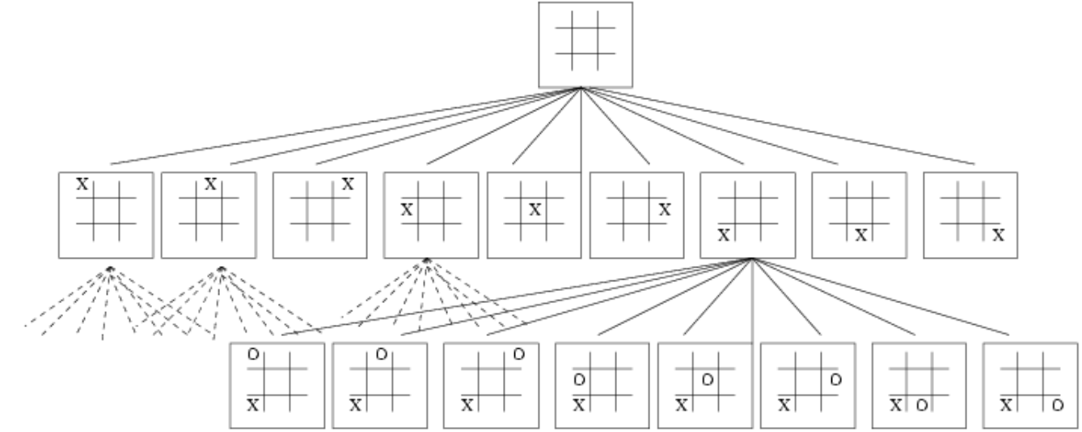
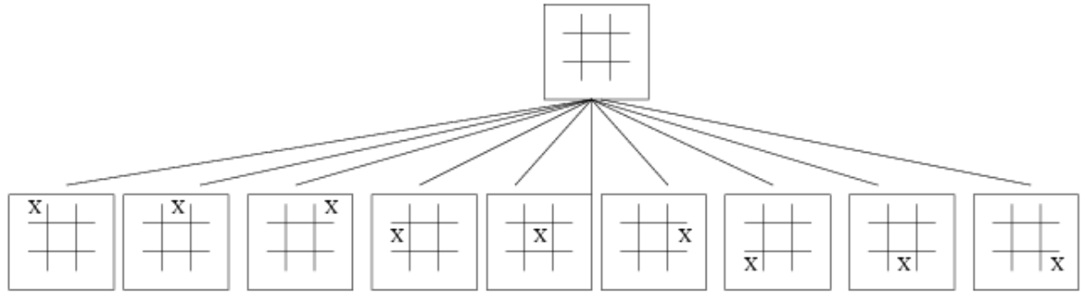
MCTS algorithm
Search tree
In a search tree :
each node is a position.
each edge is a move.

Slide 16
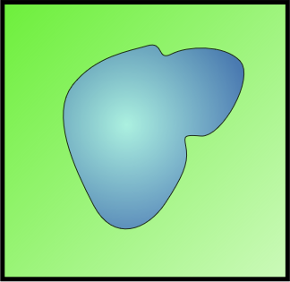
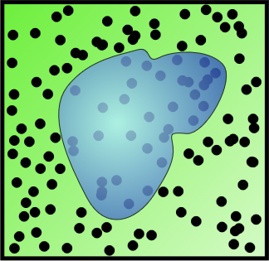
Monte Carlo Method
MCTS algorithm
Area of the field : 1km x 1km = 1km²
Area of the Lake : unknown
300 of 1000 randoms shots fell into the Lake : Probability to fall in the lake : 300/1000 = 30%
Theorical probability of falling into the lake :
Area Lake
Area Field
1km
Area Lake
Area Field
≈ 30%
Area Lake≈ 0,3 km²

Slide 17
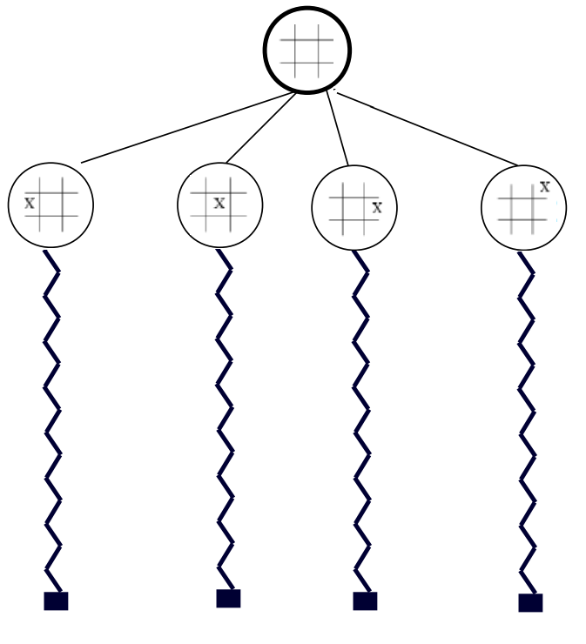
MCTS algorithm
Monte Carlo
algorithm

Slide 18
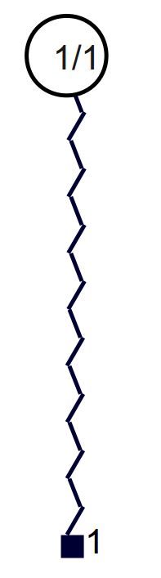
MCTS algorithm
Build a tree with all possible solutions but a small depth.
Upon reaching a leaf, play random moves.
Compute the results (win or loss) to get the odds of outcomes.

Slide 19
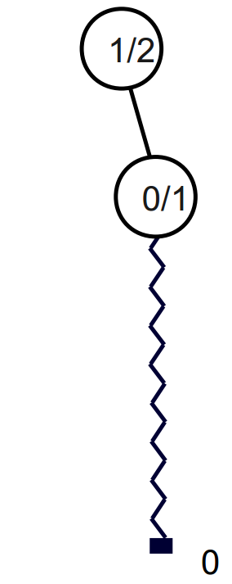
MCTS algorithm
Build a tree with all possible solutions but a small depth.
Upon reaching a leaf, play random moves.
Compute the results (win or loss) to get the odds of outcomes.

Slide 20
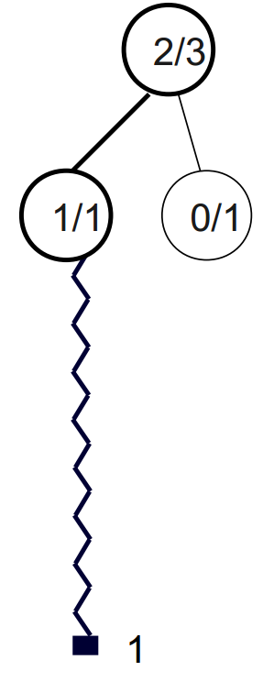
MCTS algorithm
Build a tree with all possible solutions but a small depth.
Upon reaching a leaf, play random moves.
Compute the results (win or loss) to get the odds of outcomes.

Slide 21
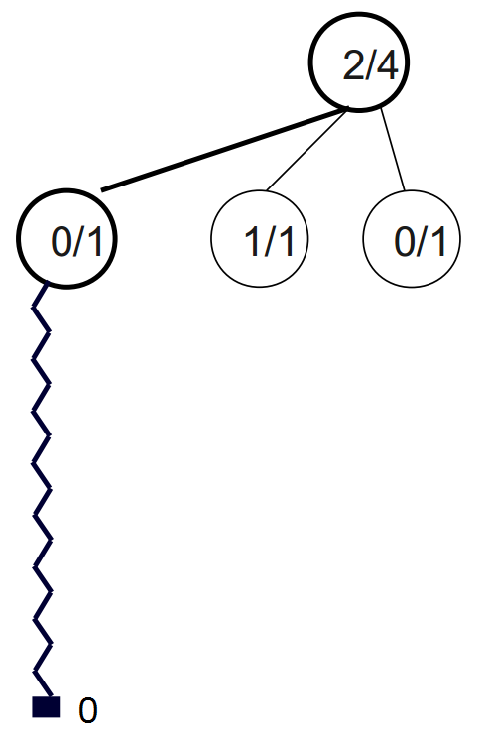
MCTS algorithm
Build a tree with all possible solutions but a small depth.
Upon reaching a leaf, play random moves.
Compute the results (win or loss) to get the odds of outcomes.

Slide 22
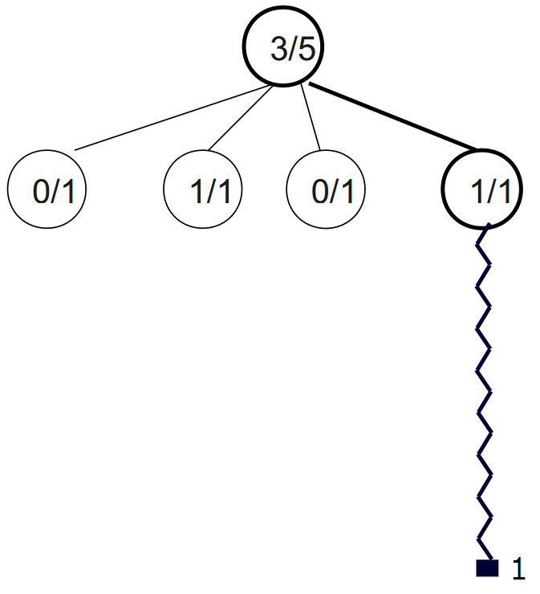
MCTS algorithm

Slide 23
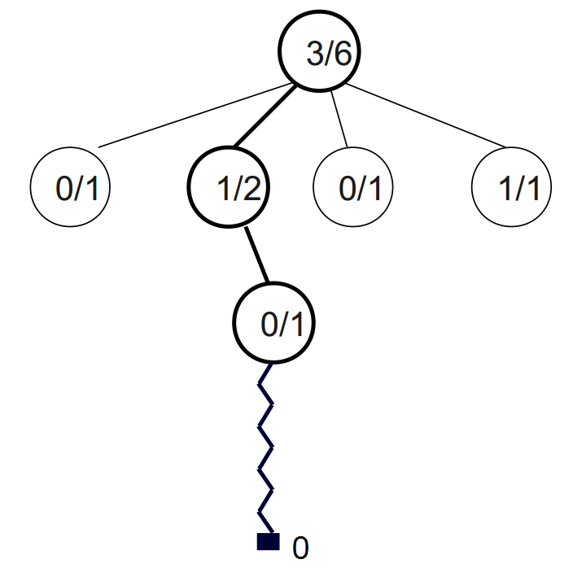
MCTS algorithm
MCTS algorithm

Slide 24
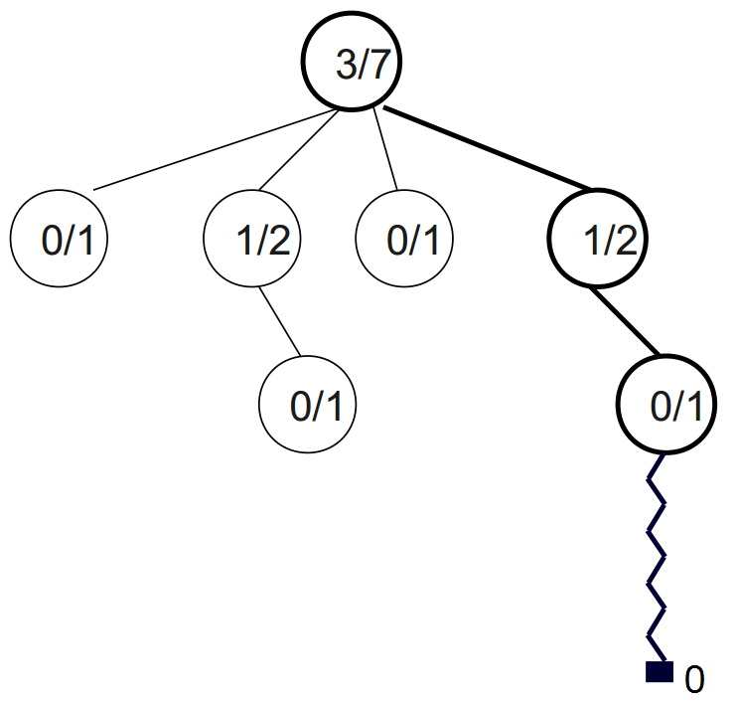
MCTS algorithm

Slide 25
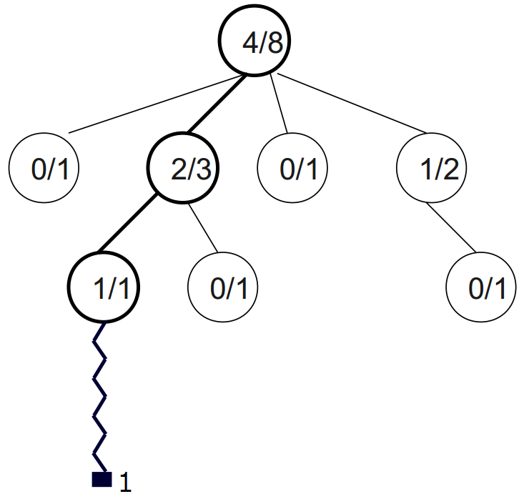
MCTS algorithm
MCTS algorithm

Slide 26
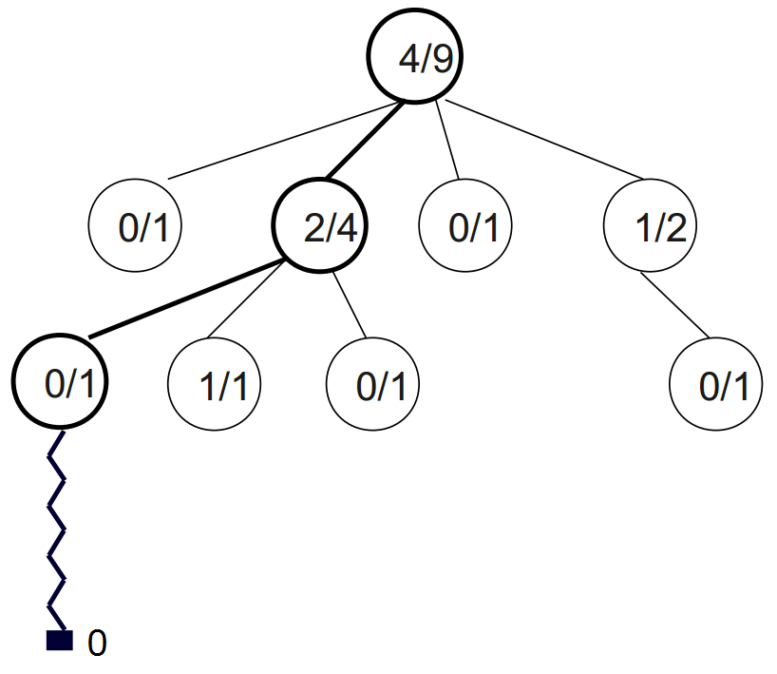
MCTS algorithm
MCTS algorithm

Slide 27
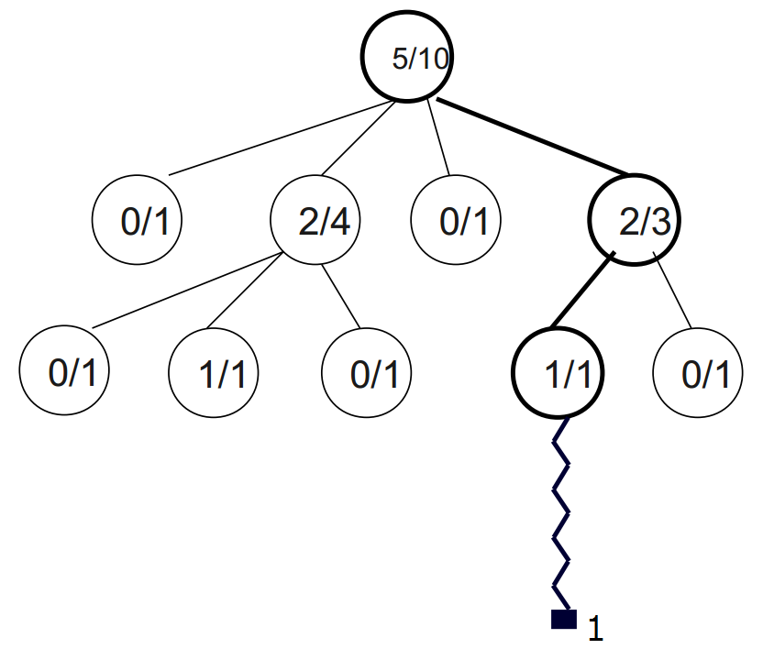
MCTS algorithm
MCTS algorithm

Slide 28
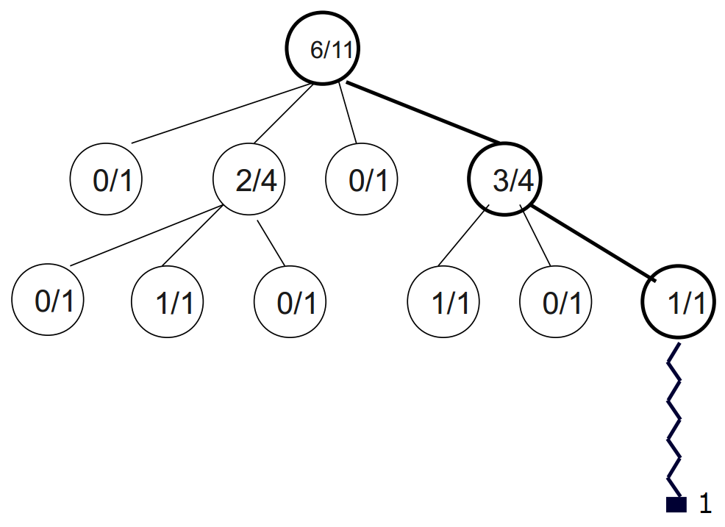
MCTS algorithm
MCTS algorithm

Slide 29
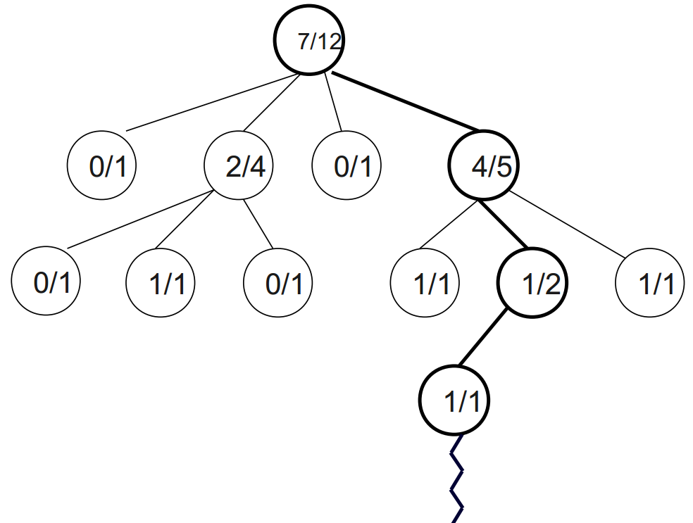
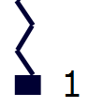
MCTS algorithm
MCTS algorithm
Chose the move with highest winrate : 4/5

Slide 30
Contents
Introduction
Arimaa presentation
MCTS algorithm
Parallelization methods
General architecture
Specifications
Development Methodologies
Conclusion

Slide 31
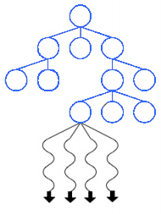
Leaf Parallelization
Parallelization methods
Global tree with parallel access of the same node for random games
+ Very basic and simple
- Need synchronization
- Need to wait for the last thread to finish : lost of efficiency

Slide 32
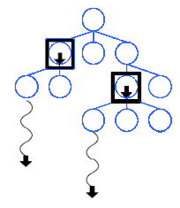
Tree Parallelization (with local mutexes)
Parallelization methods
+ Efficient
+ Does not wait for the end of all actors
- Needs to implement a solution to prevent concurrent treatments
Global tree with random access by all of the actors

Slide 33
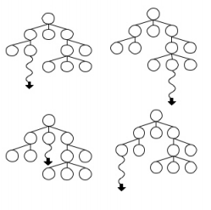
Root Parallelization
Parallelization methods
Each actor has a copy of the tree and merge it at the end of the time
+ More efficient
+ Require the minimum communication
- No communication between actors: risks of redundancy

Slide 34
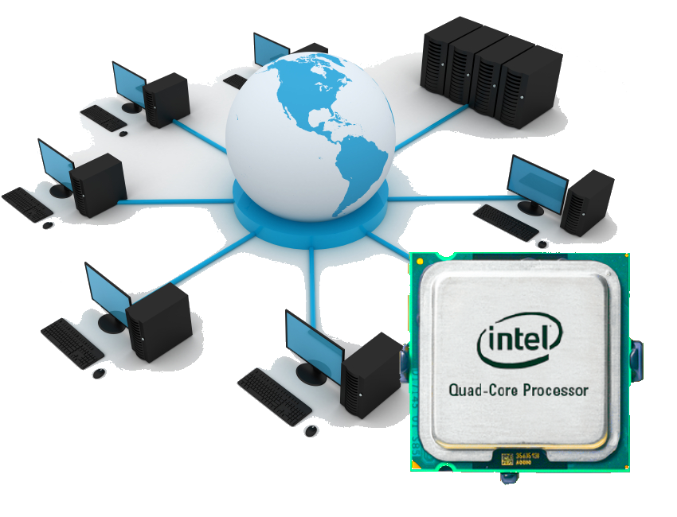
Parallelization methods
Chosen solution :
Root-Root
Efficient
Simple
Homogeneous

Slide 35
Contents
Introduction
Arimaa presentation
MCTS algorithm
Parallelization methods
General architecture
Specifications
Development Methodologies
Conclusion

Slide 36
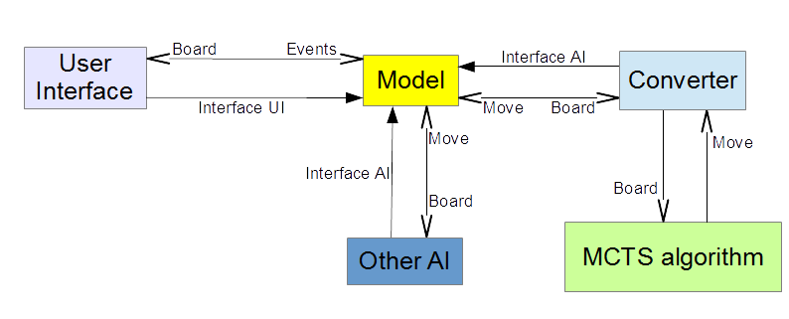
General Architecture
General view of the architecture :
4 modules:
User Interface
Model
Converter
MCTS algorithm
And possibly other AI
Notes:
In this part, we are going to study the General Architecture.
Here is the general architecture diagram. We can see the 5 modules interacting with each other.
The User Interface interacts with the environment generating events handled by the model. This module interact with the Artificial Intelligence.
In our project, it will be the MCTS algorithm, connected together thanks to a converter.
But by implementing a single interface, it will be possible for the model to interact with a bot, an other one Artificial Intelligence created by other people. Then, it will be possible to use a bot from the site Arimaa.com

Slide 37
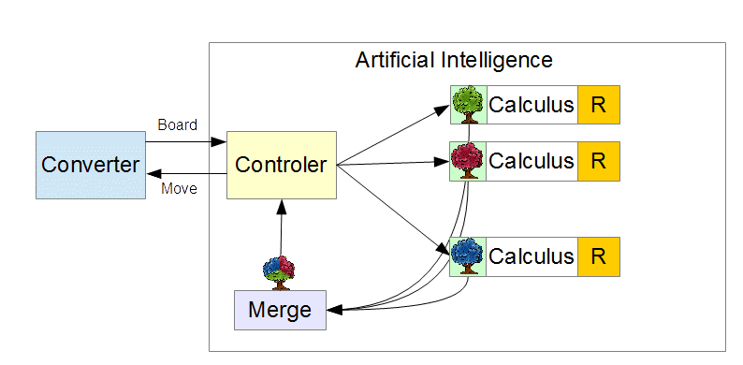
General Architecture
MCTS algorithm module
MCTS algorithm:
Parallelization: Dispatching of data in ..different threads
Calculus of moves
Set of rules
Merging the results
The controler sends the move
Notes:
The MCTS algorithm

Slide 38
Contents
Introduction
Arimaa presentation
MCTS algorithm
Parallelization methods
General architecture
Specifications
Development Methodologies
Conclusion

Slide 39


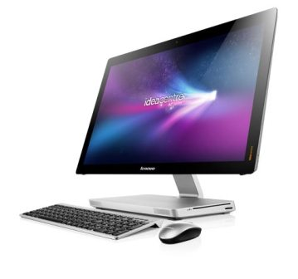
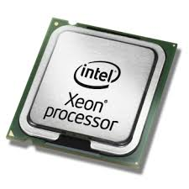
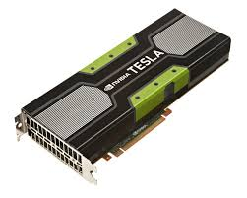
Hardware infrastructure
Specifications
Linux or Windows
Cluster or single Machine
CPU and GPU parallelization

Slide 40
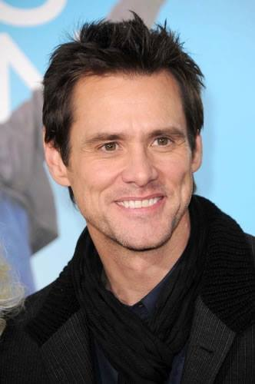
Technical solutions
Specifications
Actor model :
Dedicated programming :
Abstract concept
Actors are like working people who do not speak with each others except by email.
Clusters, computers, CPU and GPU are seen as actors
Cluster -> MPI (Message Passing Interface)
CPU -> OpenMP
GPU -> OpenACC

Slide 41
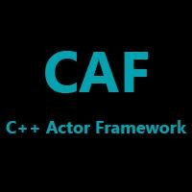
C++ Actor Framework
Specifications
Efficient implementation of Actor model
Manage clusters, CPU and GPU parallelization
May not work correctly on Windows

Slide 42
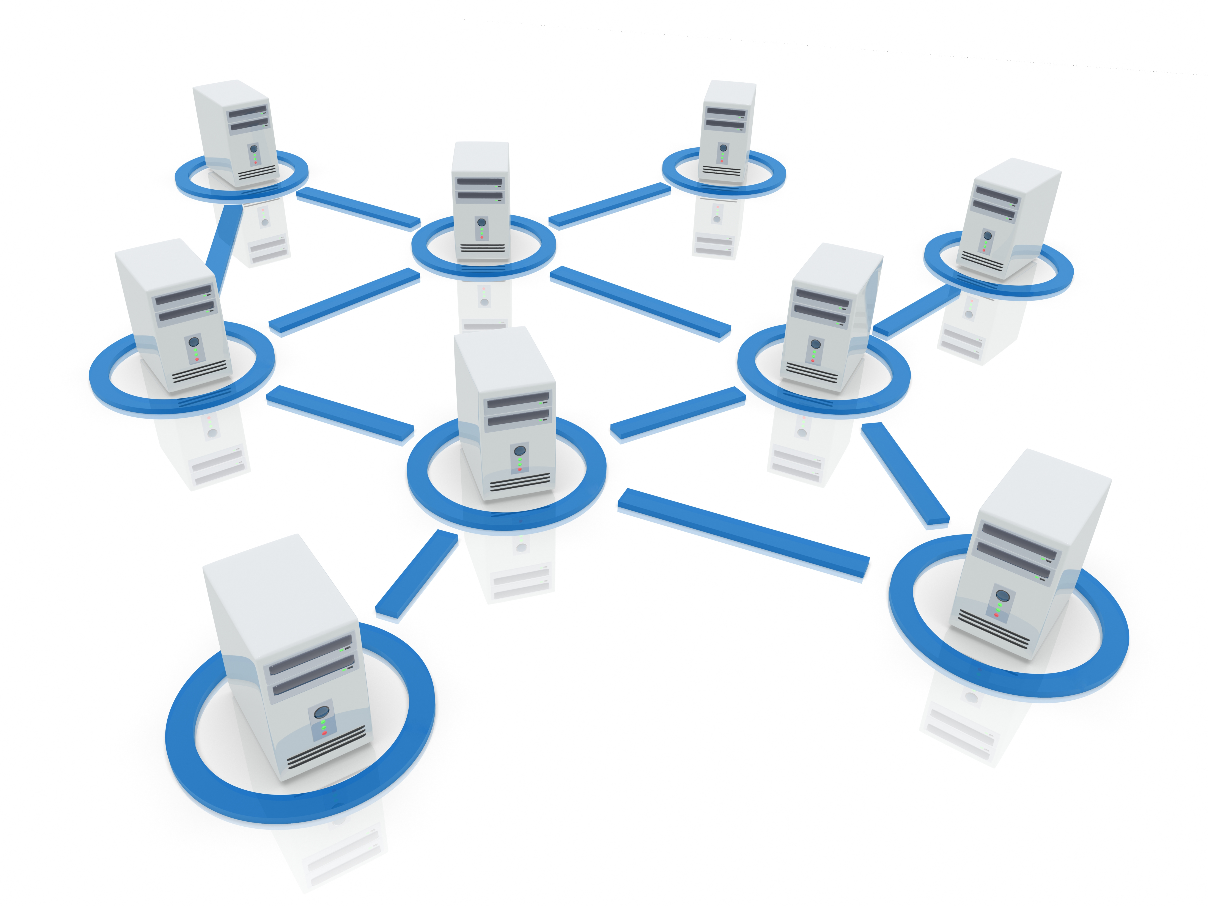
MPI
Specifications
Low-level solution
Allows synchronous or asynchronous communication
Uses messages to communicate between the process

Slide 43
OpenMP / OpenACC
Specifications
Pre-compilation instructions
Simple and quick to implement
Just a little less efficient than others possibilities like CUDA
#pragma omp parallel for for(int i = 0; i < 1 000 000; i++){ ... }
#pragma acc data copy(A), create(Anew) ...
#pragma acc kernels for(int i = 0; i < 1 000 000; i++){ ... }

Slide 44
Contents
Introduction
Arimaa presentation
MCTS algorithm
Parallelization methods
General architecture
Specifications
Development Methodologies
Conclusion

Slide 45
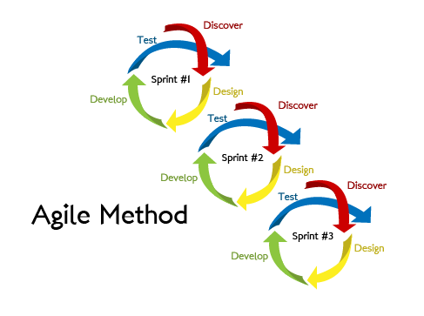
Agile Methodology:
Development Methodologies
Iterative software development methodology for building and testing the software incrementally.

Slide 46
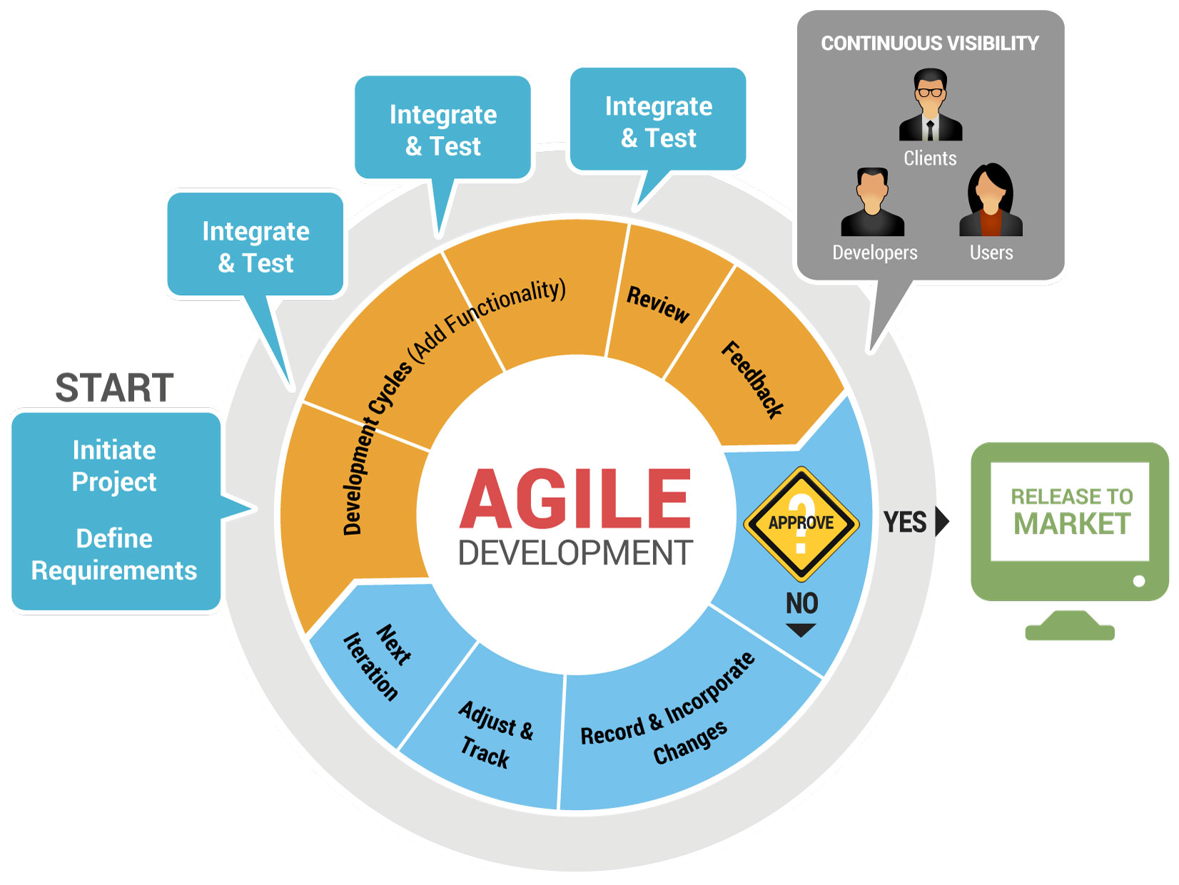
Key Areas :
Development Methodologies
Regular meetings
"To Do" list
Estimation of time and resources

Slide 47
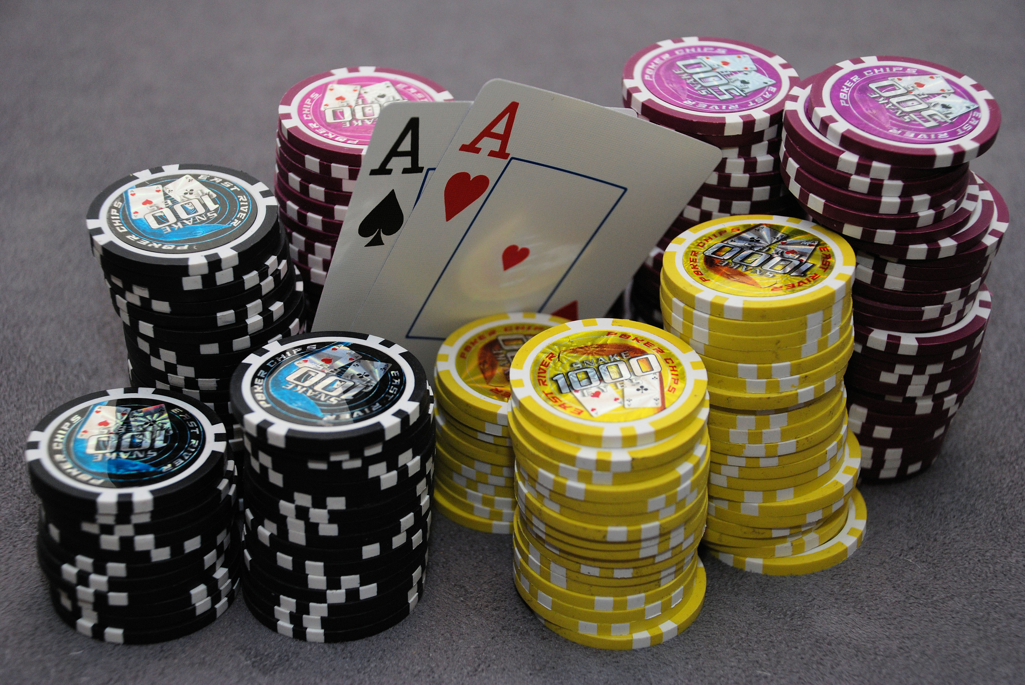
Planning Poker Estimation Technique
Development Methodologies
Method for workloads
The method:
Guess workloads individually
No influence on the others
The treatment of solutions:
Eliminate singular guesses
Discuss together what will be the workload then
 | Gabriel | Prateek | Mikaïl | Baptiste | Benoît | Dan | Final Workload
MCTS general algorithm | 7,5 | 50 | 5 | 25 | 30 | 3 | 25

Slide 48
Development Methodologies
Key Areas :
Regular meetings
"To Do" list
Estimation of time and resources
Prioritization of tasks
Development using top to bottom approach
Feedback from the end user or the team
Iterations

Slide 49
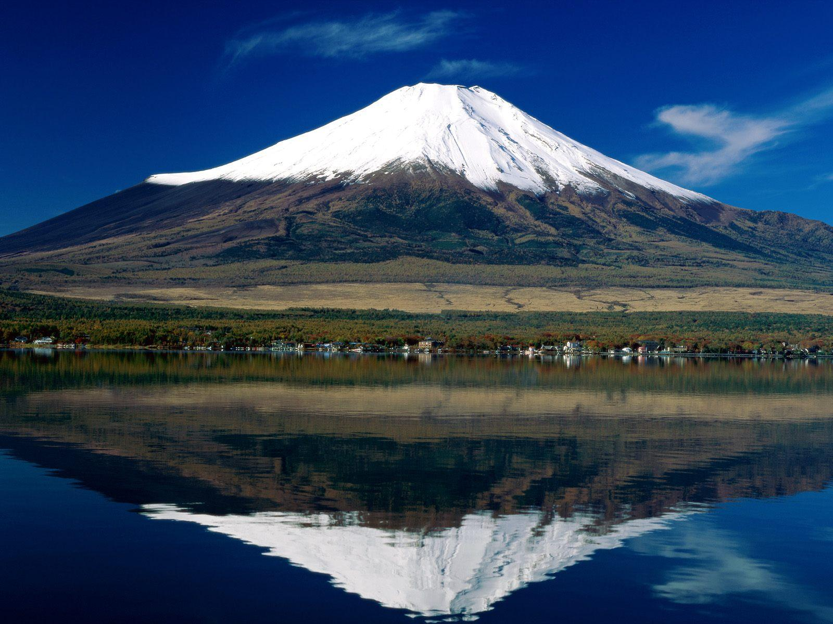
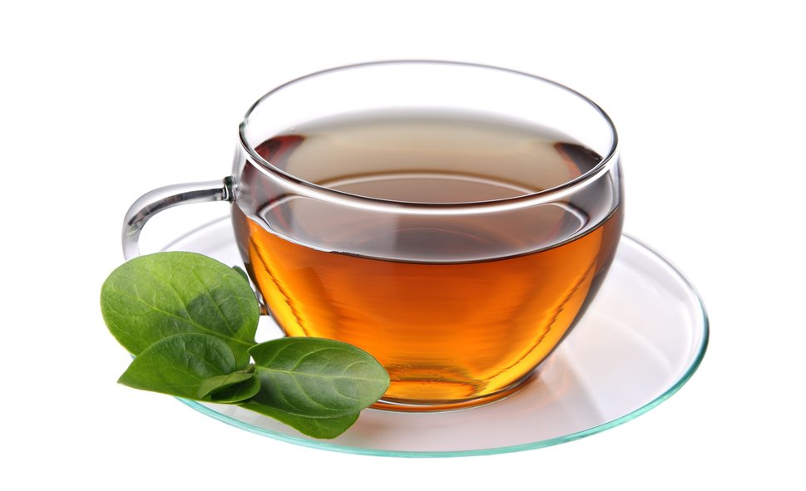

Conclusion
Implementation of an artificial intelligence for Arimaa.
Use of the Monte Carlo Tree Search algorithm
Exploitation of parallelization on a set of clusters of multi-core machines
Creation of an user interface to test the algorithm against humans

Slide 50


